Slide 1

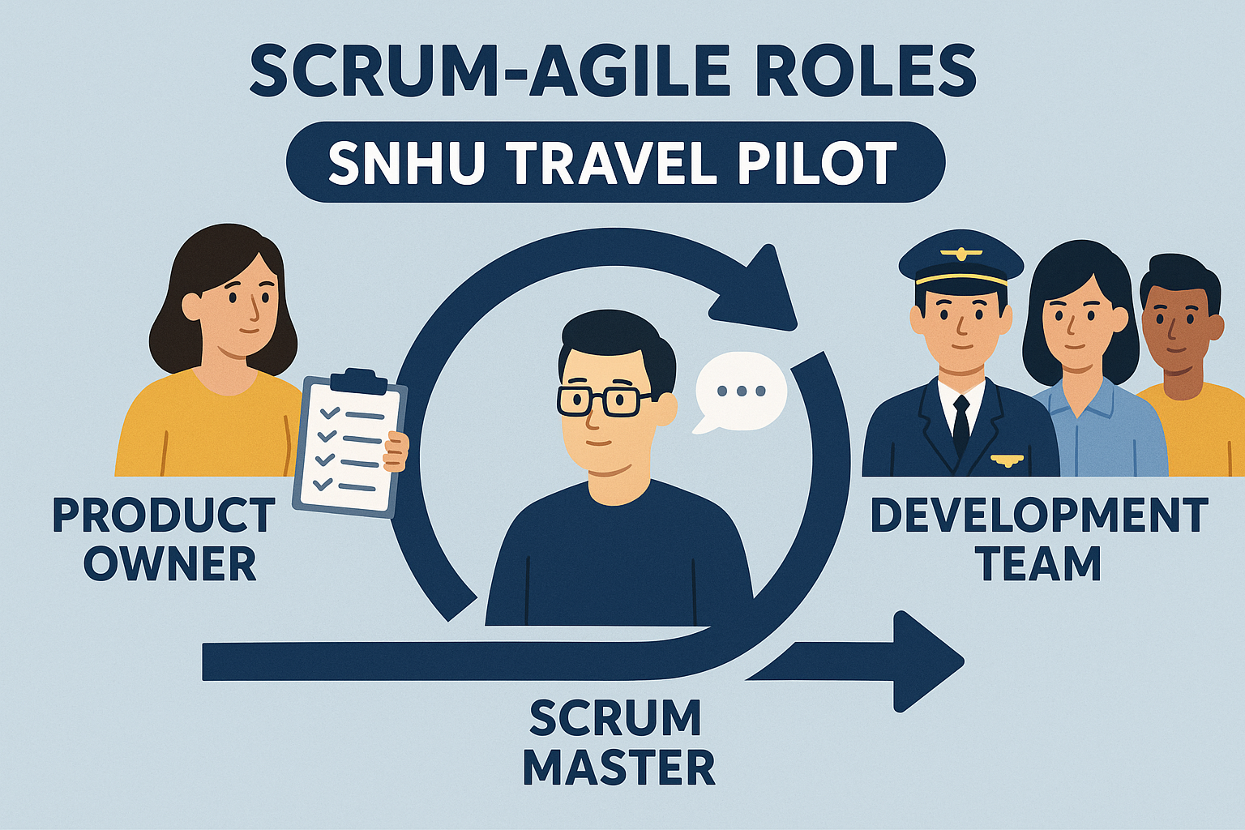

Scrum-Agile at ChadaTech
SNHU Travel Pilot • Sprint Review & Comparison to Waterfall

Slide 2
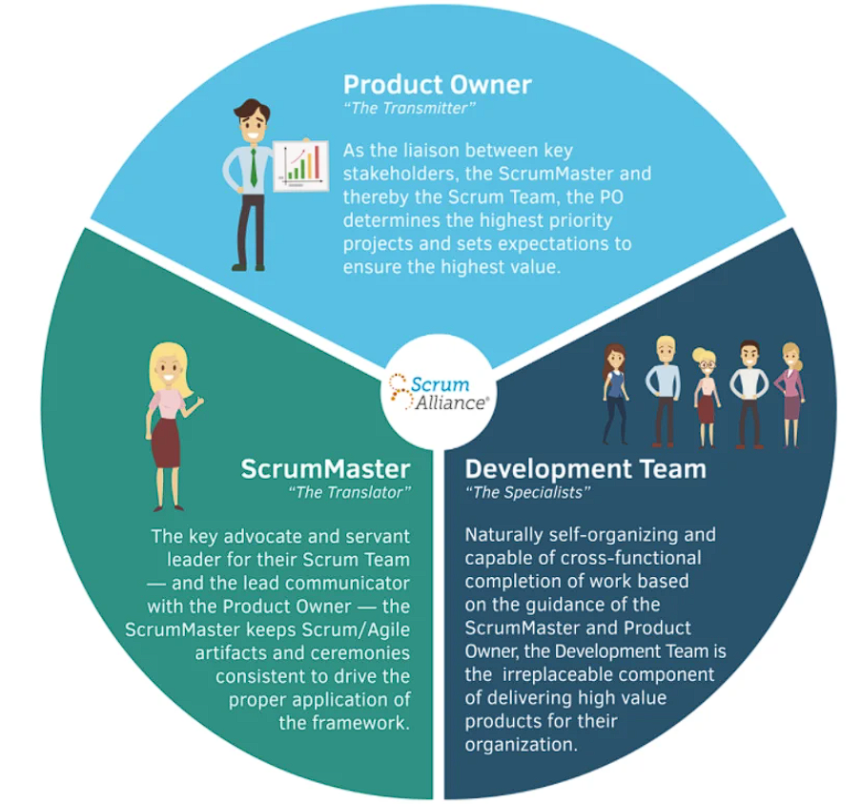
Scrum-Agile Roles
Product Owner: Orders backlog, maximizes value.
Scrum Master: Facilitates events, removes impediments, supports the team.
Developers: Build increments, ensure quality and 'Done.'

Slide 3

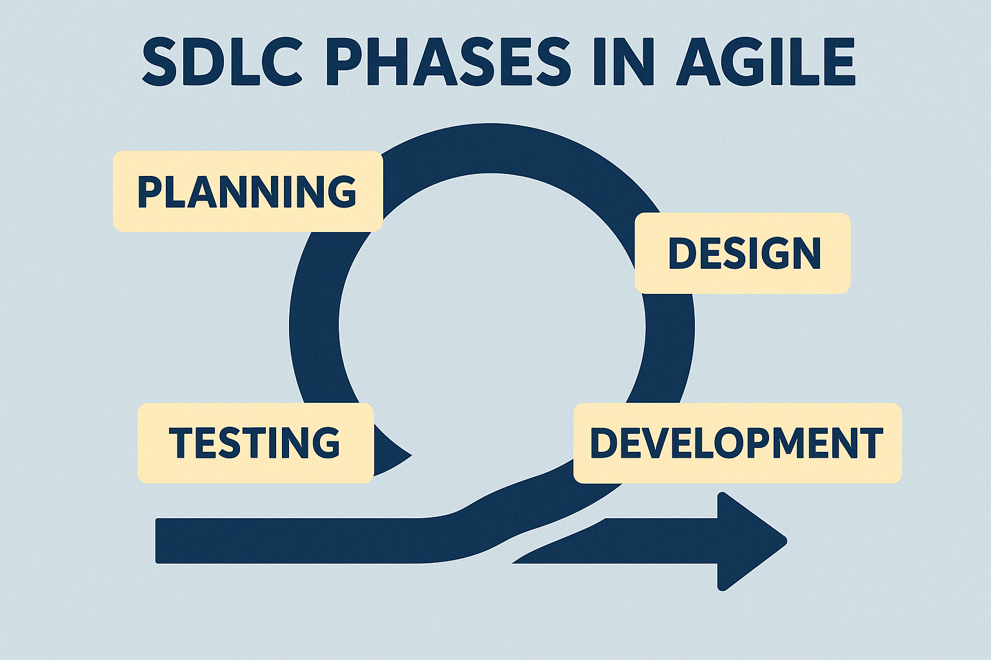
SDLC Phases in Agile
Requirements: User stories & acceptance criteria (continuous).
Design: Lightweight models, evolving architecture.
Implementation & Test: Small slices, CI, DoD.
Deployment & Maintenance: Frequent releases, backlog improvements.
Agile values empiricism: transparency, inspection, adaptation.

Slide 4

Waterfall vs Agile
Waterfall: Linear phases; requirements locked early; testing occurs late.
Agile (Scrum): Iterative sprints; continuous feedback; working software delivered early.
Waterfall: Change is costly and often resisted.
Agile: Embraces change and adapts quickly to stakeholder needs.
Hybrid: Many organizations mix approaches depending on project context (PMI, 2024).

Slide 5
Choosing Waterfall or Agile
Volatility of requirements: Agile if high change, Waterfall if stable.
Regulatory constraints: Waterfall or Hybrid may fit better.
Team/stakeholder engagement: Agile requires frequent collaboration.
Culture & readiness: Scrum needs cross-functional teamwork.

Slide 6
SNHU Travel Pilot Results
Delivered Top 10 Destinations List with clickable images.
Added wellness travel filters (detox, spa, yoga) following scope change.
Handled mid-project pivot through backlog refinement and re-estimation.
Fixed Java 8 export issue before release, ensuring compatibility.
Pros observed: Responsiveness to change, early risk detection, shared Definition of Done, improved morale.

Slide 7
Tools & Events
Jira: backlog, sprint board, burndown reports, improved visibility.
Scrum events: planning, daily, refinement, review, retrospective.
Information radiators and strict DoD boosted transparency and quality.

Slide 8
References (APA, last 5 years)
Schwaber, K., & Sutherland, J. (2020). The Scrum Guide. https://scrumguides.org
Project Management Institute. (2024). Pulse of the profession—Future of project work. https://www.pmi.org
Nieto-Rodriguez, A. (2023). It’s time to end the battle between Waterfall and Agile. Harvard Business Review. https://hbr.org
Atlassian. (n.d.). What is Scrum? Agile Coach. https://www.atlassian.com/agile/scrum
Agile Alliance. (n.d.). Agile 101. https://www.agilealliance.org

